Slide 1
University of North Carolina at Charlotte
DSBA 6160 Big data design Storage and Provenance
MIMIC-III Clinical Database Challenge-1

Slide 2
Group - 7
Muthu Priya
Farida Yada
Forrest Johnson
Shradhda Karki

Slide 3
Data Source
We are analysing the “MIMIC-III Clinical Database”.
Link to the database https://physionet.org/content/mimiciii/1.4/#files
To attain access to this database, we completed “Refresher Course” in Collaborative Institutional Training Initiative (CITI Program).

Slide 4
Data Description
MIMIC is a relational database containing tables of data relating to patients who stayed within the intensive care units at Beth Israel Deaconess Medical Center.
We have used the following tables for this project.
ADMISSIONS.csv
DIAGNOSES_ICD.csv
PATIENTS.csv
PRESCRIPTIONS.csv
PROCEDURES_ICD.csv

Slide 5
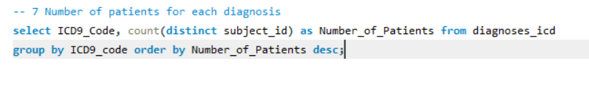
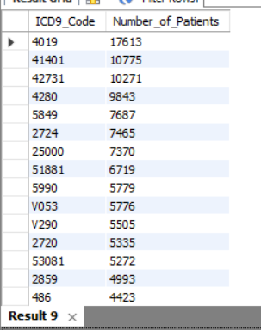
Basic Queries Screenshot

Slide 6
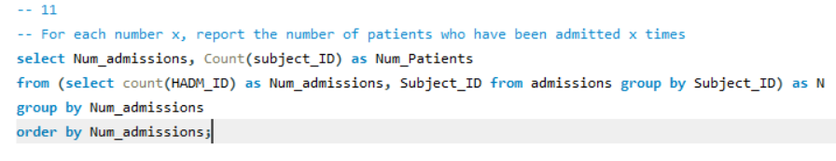
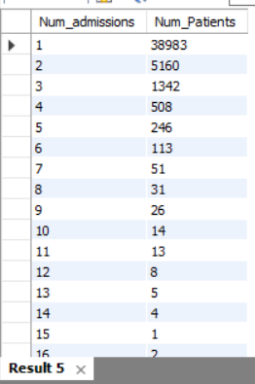
Basic Queries Screenshot (Continued)

Slide 7
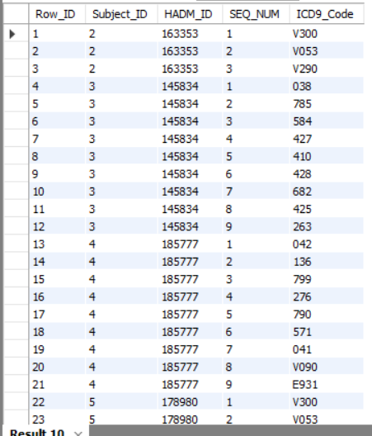
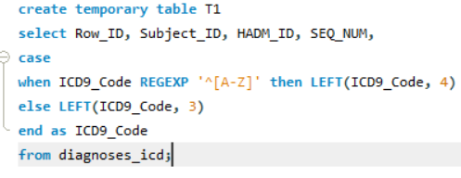
Advanced Queries Screenshot
Notes:
'[a-zA-Z]'

Slide 8
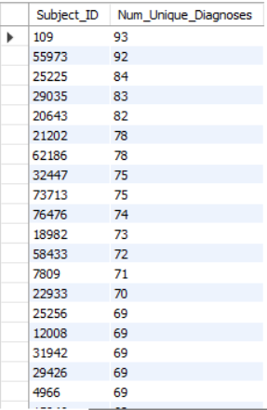
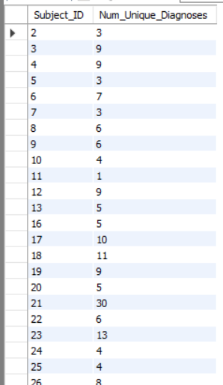


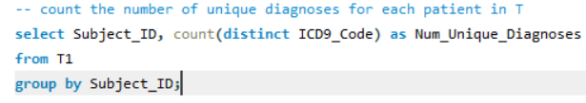
Advanced Queries Screenshot (Continued)

Slide 9
Case Study
Why Differential Privacy [3]?
Suppose, if we want to know which Diagnoses is the most common in the medical histories of a set of respondents.
The answers to these questions are highly confidential, so in order to hide the original value, we will add some noise to it. This provides privacy to the sensitive health data of individual users.
It is done through Laplace mechanism (1/ε). This method is called as Report Noisy Max algorithm.

Slide 10
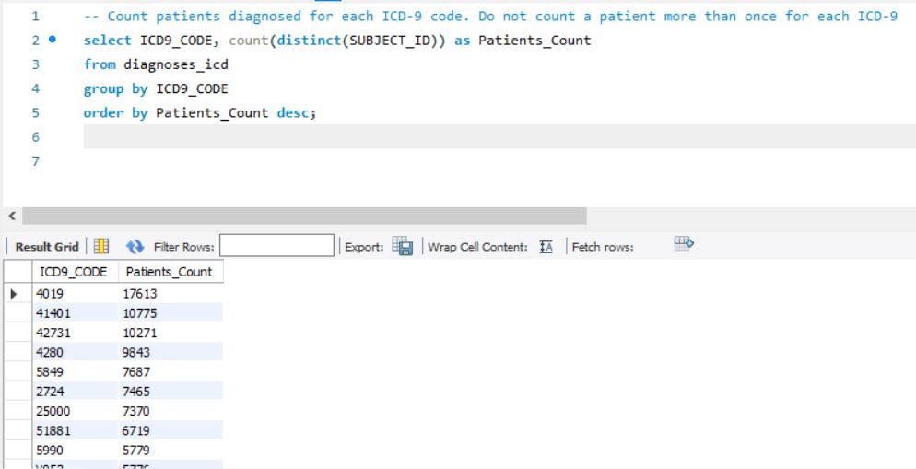
Case Study SQL Query Screenshot

Slide 11
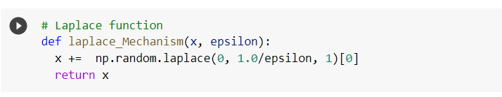
Case Study-Script & Visualization
Programming Script: Differential Privacy using Laplace function in Python
Tableau Visualization: MIMIC_Data_Most_Common_Diagnoses

Slide 12
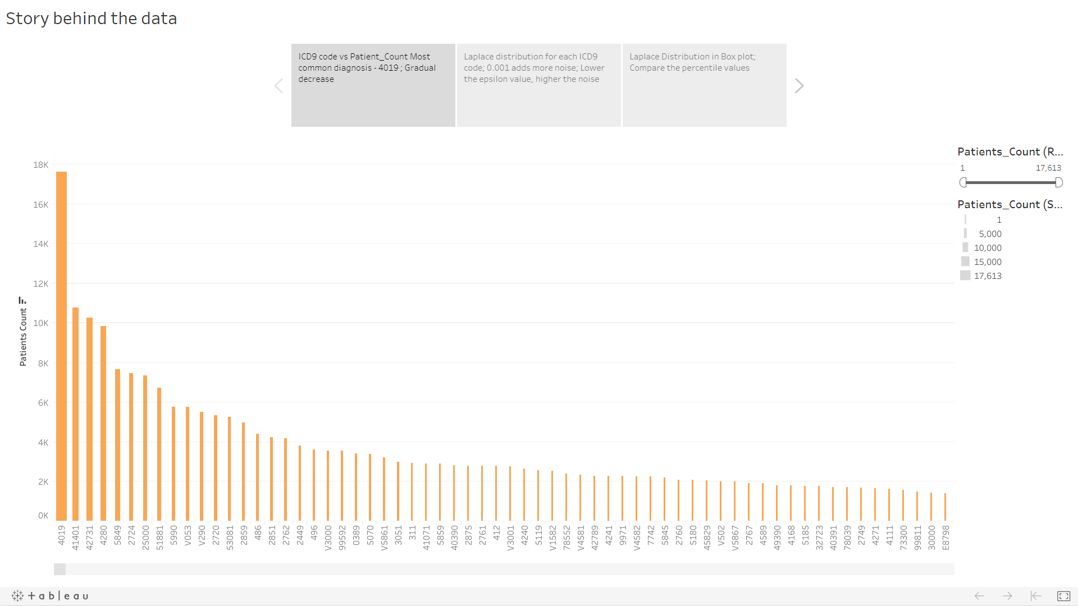
Visualization-1 Most common diagnoses
Data is displayed in descending order by patients count.
Most common Diagnoses (ICD9 code): 4019
Count of Patients in 4019 : 17,613
Notes:
Maybe mention which diseases the highest and lowest codes represent

Slide 13
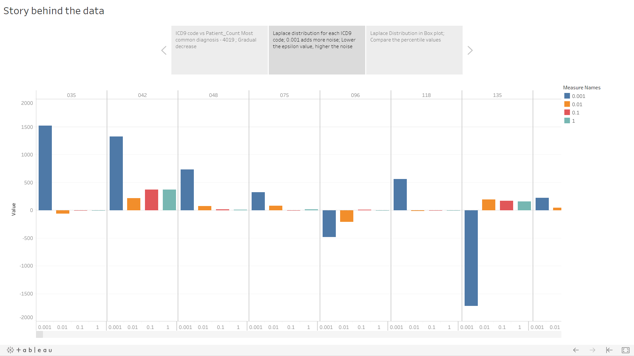
Visualization-2 Compare Epsilon values
Comparison of different epsilon-laplace mechanism for each ICD9 code.
Epsilon=0.001 added more noise to the original value.
Epsilon=1 added much less noise to the original value.
It is evident that, higher epsilon values, lower the presence of noise added to the data & vice-versa.

Slide 14
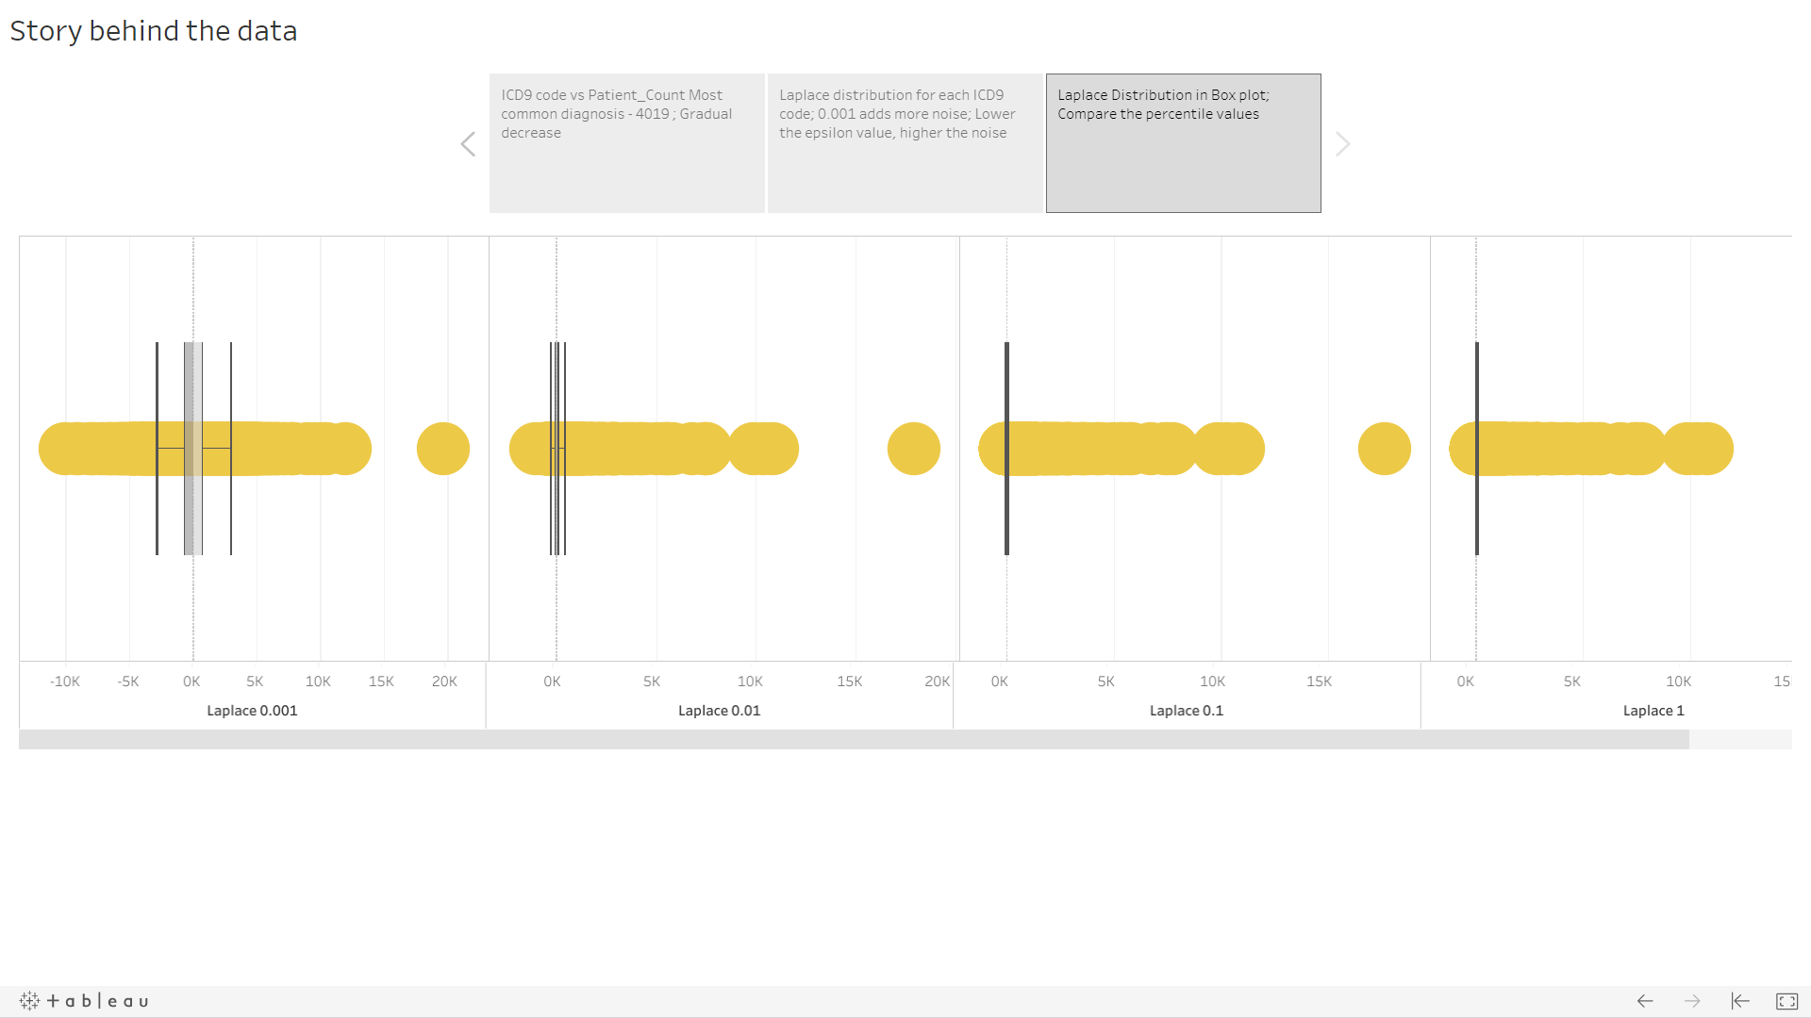
Visualization-3 Laplace Distribution
Box plot provides a visual summary of important aspects of the distribution such as the mean, median, lower & higher hinge values [4].
As the epsilon value decreases, the upper and lower bound values of the noise increases.

Slide 15
Statement of Contributions
Shradhda Karki -Basic queries, Advance queries and case study
Muthu Priya SV -Basic queries, Case study and Script
Forrest Johnson - Basic queries and Advance Queries
Farida Yada - Basic queries, Report/Slides Final Proofread/ Editing

Slide 16
References
Overview of the MIMIC-III data: https://mimic.physionet.org/gettingstarted/overview/
Link to the database: https://physionet.org/content/mimiciii/1.4/#files
Differential Privacy: https://towardsdatascience.com/understanding-differential-privacy-85ce191e198a
Box Plot: http://davidmlane.com/hyperstat/A37797.html#:~:text=A%20box%20plot%20provides%20an,the%20scores%20in%20the%20distribution.

Slide 17
Thank You !
By,
Group 7

